Slide 1
Lecture-
Chapter 8: Methods of Analysis and
Selected Topics (dc)
Abu Ahmed Ferdaus, CSE, DU.

Slide 2
This Lecture Includes:
Objectives
8.1 Introduction
8.2 Current Sources
8.3 Source Conversions
8.4 Current Sources in Parallel
8.5 Current Sources in Series
8.6 Branch-Current Analysis
8.7-8 Mesh Analysis (General and Format Approach)
8.9-10 Nodal Analysis (General and Format Approach)
Abu Ahmed Ferdaus, CSE, DU.

Slide 3
Objectives
Become familiar with the terminal characteristics of a current source and how to solve for the voltages and currents of a network using current sources and/or current sources and voltage sources.
Be able to apply branch-current analysis and mesh analysis to find the currents of network with one or more independent paths.
Be able to apply nodal analysis to find all the terminal voltages of any series-parallel network with one or more independent sources.
Become familiar with bridge network configurations and how to perform Δ-Y or Y-Δ conversions.
Abu Ahmed Ferdaus, CSE, DU.

Slide 4
8.1 Introduction
The circuits described in the previous chapters had only one source or two or more sources in series or parallel.
The step-by-step procedures outlined in those chapters can be applied only if the sources are in series or parallel.
There will be an interaction of sources that will not permit the reduction techniques used to find quantities such as the total resistance and the source current.
For such situations, methods of analysis have been developed that allow us to approach, in a systematic manner, networks with any number of sources in any arrangement.
Abu Ahmed Ferdaus, CSE, DU.

Slide 5
8.1 Introduction
To our benefit, the methods to be introduced can also be applied to networks with only one source or to networks in which sources are in series or parallel.
The methods to be introduced in this chapter include:
  branch-current analysis,
  mesh analysis, and
  nodal analysis.
Each can be applied to the same network, although usually one is more appropriate than the other.
The “best” method cannot be defined by a strict set of rules but can be determined only after developing an understanding of the relative advantages of each.
Abu Ahmed Ferdaus, CSE, DU.

Slide 6
8.1 Introduction
All the methods can be applied to linear bilateral networks.
The term linear indicates that the characteristics of the network elements (such as the resistors) are independent of the voltage across or current through them.
The second term, bilateral, refers to the fact that there is no change in the behavior or characteristics of an element if the current through or voltage across the element is reversed.
Of the three methods listed above, the branch-current method is the only one not restricted to bilateral devices.
Abu Ahmed Ferdaus, CSE, DU.

Slide 7
8.2 Current Source
The voltage source was the only source appearing in the circuit analysis so far. This was primarily because voltage sources such as the battery and supply are the most common in our daily lives and in the laboratory environment.
Now let us turn our attention to a second type of source called the current source.
Although current sources are available as laboratory supplies, they appear extensively in the modeling of electronic devices such as the transistor.
Their characteristics and their impact on the currents and voltages of a network must therefore be clearly understood if electronic systems are to be properly investigated.
Abu Ahmed Ferdaus, CSE, DU.

Slide 8
8.2 Duality of Voltage &Current Source
The current source is often referred to as the dual of the voltage source.
Just as a battery provides a fixed voltage to a network, a current source establishes a fixed current in the branch where it is located.
Further, the current through a battery is a function of the network to which it is applied, just as the voltage across a current source is a function of the connected network.
The term dual is applied to any two elements in which the traits (behavior) of one variable can be interchanged with the traits of another. This is certainly true for the current and voltage of the two types of sources.
Abu Ahmed Ferdaus, CSE, DU.

Slide 9
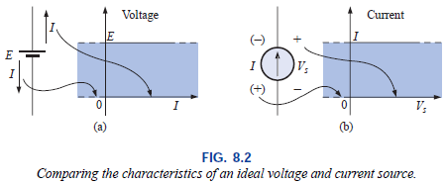
8.2 Voltage Source Vs Current Source
For the voltage source, the terminal voltage is fixed at E volts independent of the direction of the current I. The direction and magnitude of I will be determined by the network to which the supply is connected.
The characteristics of the ideal current source reveal that the magnitude of the supply current is independent of the polarity of the voltage across the source. The polarity and magnitude of the source voltage Vs will be determined by the network to which the source is connected.
Abu Ahmed Ferdaus, CSE, DU.

Slide 10
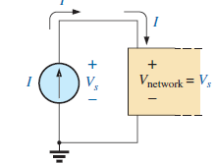
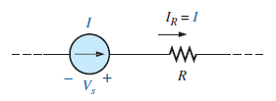
8.2 Symbol of Current Source
The symbol for a current source appears below. The arrow indicates the direction in which it is supplying current to the branch where it is located. The result is a current equal to the source current through the series resistor.
In Fig. 8.1(b), we find that the voltage across a current source is determined by the polarity of the voltage drop caused by the current source.
For single-source networks, it always has the polarity of Fig. 8.1(b), but for multisource networks it can have either polarity.
Abu Ahmed Ferdaus, CSE, DU.

Slide 11
8.2 Current Source
In general, therefore
a current source determines the direction and magnitude of the current in the branch where it is located.
Furthermore
the magnitude and the polarity of the voltage across a current source are each a function of the network to which the voltage is applied.
Abu Ahmed Ferdaus, CSE, DU.

Slide 12
8.2 Examples: Current Source
The following few examples will demonstrate the similarities between solving for the source current of a voltage source and the terminal voltage of a current source.
Example 8.1 – Ideal Current Source
Example 8.2 – Combination of Current and Voltage Source
Example 8.3 - polarity of the voltage Vs as determined by the network.
Abu Ahmed Ferdaus, CSE, DU.

Slide 13
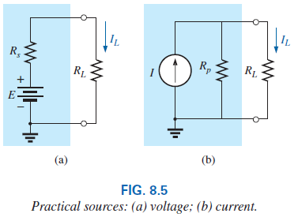
8.3 Source Conversion
The current source appearing in the previous section is called an ideal source due to the absence of any internal resistance.
In reality, all sources—whether they are voltage or current—have some internal resistance in the relative positions.
Abu Ahmed Ferdaus, CSE, DU.

Slide 14
8.3 Source Conversion
For the voltage source, if Rs = 0 Ω or if it is so small compared to any series resistor that it can be ignored, then we have an “ideal” voltage source for all practical purposes.
For the current source, since the resistor R_{P} is in parallel, if Rp = ∞ Ω or if it is large enough compared to other parallel elements that it can be ignored, then we have an “ideal” current source.
Unfortunately, however, ideal sources cannot be converted from one type to another. That is, a voltage source cannot be converted to a current source, and vice versa—the internal resistance must be present.
Abu Ahmed Ferdaus, CSE, DU.

Slide 15
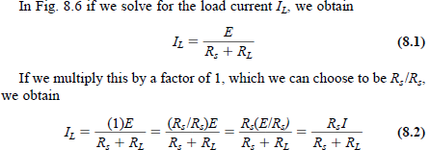
8.3 Source Conversion
We want the equivalence to ensure that the applied load will receive the same current, voltage, and power from each source and in effect not know, or care, which source is present.
Abu Ahmed Ferdaus, CSE, DU.

Slide 16

8.3 Source Conversion
This type of equivalence is established using the equations appearing in Fig. 8.6. First note that the resistance is the same in each configuration— a nice advantage.
For the voltage source equivalent, the voltage determined by a simple application of Ohm’s law to the current source: E = IR_{P}.
For the current source equivalent, the current is again determined by applying Ohm’s law to the voltage source: I = E/R_{s}.
Abu Ahmed Ferdaus, CSE, DU.

Slide 17
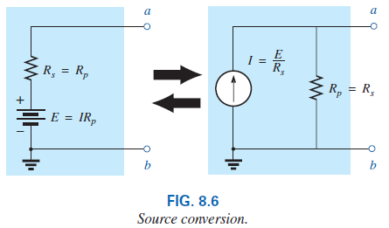
8.3 Source Conversion
It is important to realize, however, that
the equivalence between a current source and a voltage source exists only at their external terminals.
The internal characteristics of each are quite different.
Abu Ahmed Ferdaus, CSE, DU.

Slide 18
8.3 Examples: Source Conversion
Example 8.4 - a source and its equivalent will establish current in the same direction through the applied load.
Example 8.5
Abu Ahmed Ferdaus, CSE, DU.

Slide 19
8.4 Current Sources in Parallel
We found that voltage sources of different terminal voltages cannot be placed in parallel because of a violation of Kirchhoff’s voltage law.
Similarly, current sources of different values cannot be placed in series due to a violation of Kirchhoff’s current law.
However, current sources can be placed in parallel just as voltage sources can be placed in series.
In general, two or more current sources in parallel can be replaced by a single current source having a magnitude determined by the difference of the sum of the currents in one direction and the sum in the opposite direction. The new parallel internal resistance is the total resistance of the resulting parallel resistive elements.
Abu Ahmed Ferdaus, CSE, DU.

Slide 20
8.4 Current Sources in Parallel
Example: 8.6
Example: 8.7
Example: 8.8
Abu Ahmed Ferdaus, CSE, DU.

Slide 21
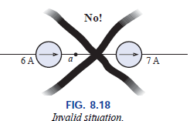
8.5 Current Sources in Series
The current through any branch of a network can be only single-valued.
For the situation indicated at point a, we find by application of Kirchhoff’s current law that the current leaving that point is greater than that entering—an impossible situation.
Therefore, current sources of different current ratings are not connected in series, just as voltage sources of different voltage ratings are not connected in parallel.
Abu Ahmed Ferdaus, CSE, DU.

Slide 22
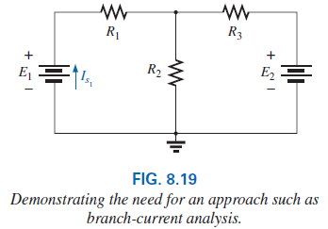
8.6 Branch-Current Analysis
Needs for the method:
Let us examine the network in Fig. 8.19 to be sure that you understand the need for these special methods.
Initially, it may appear that we can use the reduce and return approach to work our way back to the source E₁ and calculate the source current.
Unfortunately, however, the series elements R₃ and E₂ cannot be combined because they are different types of elements.
A further examination of the network reveals that there are no two like elements that are in series or parallel.
No combination of elements can be performed, and it is clear that another approach must be defined.
Abu Ahmed Ferdaus, CSE, DU.

Slide 23
8.6 Branch-Current Analysis
Method for solving networks with two or more sources.
Once the branch-current method is mastered, there is no linear dc network for which a solution cannot be found.
This method will produce the current through each branch of the network, the branch current. Once this is known, all other quantities, such as voltage or power, can be determined.
1. Assign a distinct current of arbitrary direction to each branch of the network.
2. Indicate the polarities for each resistor as determined by the assumed current direction.
3. Apply Kirchhoff’s voltage law around each closed, independent loop of the network.
Abu Ahmed Ferdaus, CSE, DU.

Slide 24
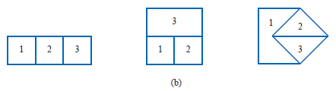


8.6 Branch-Current Analysis
The best way to determine how many times Kirchhoff’s voltage law will have to be applied is to determine the number of “windows” in the network.
4. Apply Kirchhoff’s current law at the minimum number of nodes that will include all the branch currents of the network.
Abu Ahmed Ferdaus, CSE, DU.

Slide 25
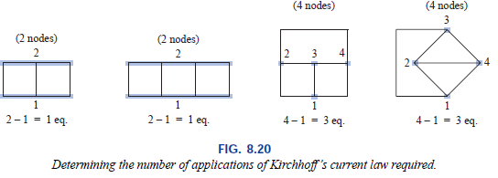
8.6 Branch-Current Analysis
The minimum number is one less than the number of independent nodes of the network. For the purposes of this analysis, a node is a junction of two or more branches, where a branch is any combination of series elements.
Solve the resulting simultaneous linear equations for assumed branch currents. (Determinants Method)
Abu Ahmed Ferdaus, CSE, DU.

Slide 26
8.6 Branch-Current Analysis
Example 8.9
Example 8.10
Abu Ahmed Ferdaus, CSE, DU.

Slide 27
8.7 Mesh Analysis (General Approach)
The term mesh is derived from the similarities in appearance between the closed loops of a network and a wire mesh fence.
This approach is on a more sophisticated plane than the branch-current method. And, of the two methods, mesh analysis is the one more frequently applied today.
Branch-current analysis is introduced as a stepping stone to mesh analysis because branch currents are initially more “real” to the student than the mesh (loop) currents employed in mesh analysis. Essentially, the mesh-analysis approach simply eliminates the need to substitute the results of Kirchhoff’s current law into the equations derived from Kirchhoff’s voltage law.
Abu Ahmed Ferdaus, CSE, DU.

Slide 28
8.7 Mesh Analysis (General Approach)
The systematic approach outlined below should be followed when applying this method.
1. Assign a distinct current in the clockwise direction to each independent, closed loop of the network. It is not absolutely necessary to choose the clockwise direction for each loop current. In fact, any direction can be chosen for each loop current with no loss in accuracy, as long as the remaining steps are followed properly. However, by choosing the clockwise direction as a standard, we can develop a shorthand method (Section 8.8) for writing the required equations that will save time and possibly prevent some common errors.
Abu Ahmed Ferdaus, CSE, DU.

Slide 29
8.7 Mesh Analysis
Place a loop current within each “window” of the network.
The number of loop currents required is always equal to the number of windows of a planar (no-crossovers) network.
On occasion a network may appear to be non-planar, a redrawing of the network may reveal that it is, in fact, planar.
A loop current is a branch current only when it is the only loop current assigned to that branch, otherwise a branch current may be resultant of the 2 or more loop currents.
Abu Ahmed Ferdaus, CSE, DU.

Slide 30
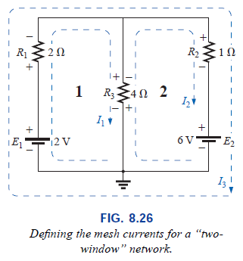
8.7 Mesh Analysis
Abu Ahmed Ferdaus, CSE, DU.

Slide 31
8.7 Mesh Analysis
2. Indicate the polarities within each loop for each resistor as determined by the assumed direction of loop current for that loop. Note the requirement that the polarities be placed within each loop. This requires, as shown in Fig. 8.26, that the 4- resistor have two sets of polarities across it.
3. Apply Kirchhoff’s voltage law around each closed loop in the clockwise direction. Again, the clockwise direction was chosen to establish uniformity and prepare us for the method to be introduced in the next section.
Abu Ahmed Ferdaus, CSE, DU.

Slide 32
8.7 Mesh Analysis
A. If a resistor has two or more assumed currents through it, the total current through the resistor is the assumed current of the loop in which Kirchhoff’s voltage law is being applied, plus the assumed currents of the other loops passing through in the same direction, minus the assumed currents through in the opposite direction.
b. The polarity of a voltage source is unaffected by the direction of the assigned loop currents.
4. Solve the resulting simultaneous linear equations for the assumed loop currents.
Abu Ahmed Ferdaus, CSE, DU.

Slide 33
8.7 Mesh Analysis
Example 8.11
Example 8.12
Example 8.13
Abu Ahmed Ferdaus, CSE, DU.

Slide 34
8.7 Supermesh Currents
On occasion there will be current sources in the network to which mesh analysis is to be applied.
In such cases one can convert the current source to a voltage source (if a parallel resistor is present) and proceed as before.
Otherwise, utilize a supermesh current and proceed as follows:
Start as before and assign a mesh current to each independent loop, including the current sources, as if they were resistors or voltage sources.
Then mentally (redraw the network if necessary) remove the current sources (replace with open-circuit equivalents), and apply Kirchhoff’s voltage law to all the
Abu Ahmed Ferdaus, CSE, DU.

Slide 35
8.7 Supermesh Currents
remaining independent paths of the network using the mesh currents just defined.
Any resulting path, including two or more mesh currents, is said to be the path of a supermesh current.
Then relate the chosen mesh currents of the network to the independent current sources of the network, and solve for the mesh currents.
The next example will clarify the definition of a supermesh current and the procedure.
However, the supermesh approach requires that we stick with the original definition of each mesh current and not alter those definitions when current sources are removed.
Abu Ahmed Ferdaus, CSE, DU.

Slide 36
8.7 Supermesh Currents
Example 8.14
Example 8.15
Abu Ahmed Ferdaus, CSE, DU.

Slide 37
8.8 Mesh Analysis (Format Approach)
1. Assign a loop current to each independent, closed loop (as in the previous section) in a clockwise direction.
The number of required equations is equal to the number of chosen independent, closed loops.
Column 1 of each equation is formed by summing the resistance values of those resistors through which the loop current of interest passes and multiplying the result by that loop current.
We must now consider the mutual terms, which are always subtracted from the first column. A mutual term is simply any resistive element having an additional loop current passing through it.
Abu Ahmed Ferdaus, CSE, DU.

Slide 38
8.8 Mesh Analysis (Format Approach)
It is possible to have more than one mutual term if the loop current of interest has an element in common with more than one other loop current.
Each term is the product of the mutual resistor and the other loop current passing through the same element.
The column to the right of the equality sign is the algebraic sum of the voltage sources through which the loop current of interest passes. Positive signs are assigned to those sources of voltage having a polarity such that the loop current passes from the negative to the positive terminal. A negative sign is assigned to those potentials for which the reverse is true.
Abu Ahmed Ferdaus, CSE, DU.

Slide 39
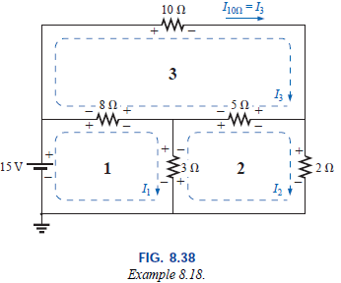
8.8 Mesh Analysis (Format Approach)
Abu Ahmed Ferdaus, CSE, DU.

Slide 40
8.8 Mesh Analysis (Format Approach)
5. Solve the resulting simultaneous equations for the desired loop currents.
Be aware that since the column to the right of the equals sign is the algebraic sum of the voltage sources in that loop, the format approach can be applied only to networks in which all current sources have been converted to their equivalent voltage source.
Abu Ahmed Ferdaus, CSE, DU.

Slide 41
8.8 Mesh Analysis (Format Approach)
Example 8.16
Example 8.17
Example 8.18
Abu Ahmed Ferdaus, CSE, DU.

Slide 42
8.9 Nodal Analysis (General Approach)
Nodal analysis—a method that provides the nodal voltages of a network, that is, the voltage from the various nodes (junction points) of the network to ground. The method is developed through the use of Kirchhoff’s current law in much the same manner as Kirchhoff’s voltage law was used to develop the mesh analysis approach.
Although it is not a requirement, we make it a policy to make ground our reference node and assign it a potential level of zero volts. All the other voltage levels are then found with respect to this reference level. For a network of N nodes, by assigning one as our reference node, we have (N - 1) nodes for which the voltage must be determined. In other words,
Abu Ahmed Ferdaus, CSE, DU.

Slide 43
8.9 Nodal Analysis (General Approach)
the number of nodes for which the voltage must be determined using nodal analysis is 1 less than the total number of nodes.
The result of the above is (N - 1) nodal voltages that need to be determined, requiring that (N - 1) independent equations be written to find the nodal voltages. In other words,
the number of equations required to solve for all the nodal voltages of a network is 1 less than the total number of independent nodes.
Since each equation is the result of an application of Kirchhoff’s current law, Kirchhoff’s current law must be applied (N - 1) times for each network.
Abu Ahmed Ferdaus, CSE, DU.

Slide 44
8.9 Nodal Analysis Procedure
1. Determine the number of nodes within the network.
2. Pick a reference node, and label each remaining node with a subscripted value of voltage: V1, V2, and so on.
3. Apply Kirchhoff’s current law at each node except the reference. Assume that all unknown currents leave the node for each application of Kirchhoff’s current law. In other words, for each node, don’t be influenced by the direction that an unknown current for another node may have had. Each node is to be treated as a separate entity, independent of the application of Kirchhoff’s current law to the other nodes.
4. Solve the resulting equations for the nodal voltages.
Abu Ahmed Ferdaus, CSE, DU.

Slide 45
8.9 Nodal Analysis (General Approach)
Example: 8.19
Example: 8.20
Example: 8.21
Abu Ahmed Ferdaus, CSE, DU.

Slide 46
8.9 Nodal Analysis (Super Node)
Occasionally, you may encounter voltage sources in a network that do not have a series internal resistance that would permit a conversion to a current source. In such cases, you have two options:
1. The simplest and most direct approach is to place a resistor in series with the source of a very small value compared to the other resistive elements of the network.
2. The other approach is to use the Supernode approach. This approach provides an exact solution but requires some practice to become proficient.
Start as usual and assign a nodal voltage to each independent node of the network, including each independent voltage source as if it were a resistor or current source.
Abu Ahmed Ferdaus, CSE, DU.

Slide 47
8.9 Nodal Analysis (Super Node)
Then mentally replace the independent voltage sources with short-circuit equivalents, and apply Kirchhoff’s current law to the defined nodes of the network.
Any node including the effect of elements tied only to other nodes is referred to as a supernode (since it has an additional number of terms).
Finally, relate the defined nodes to the independent voltage sources of the network, and solve for the nodal voltages.
Example: 8.22
Abu Ahmed Ferdaus, CSE, DU.

Slide 48
8.10 Nodal Analysis (Format Approach)
This allows us to write nodal equations rapidly and in a form that is convenient for the use of determinants.
A major requirement, however, is that all voltage sources must first be converted to current sources before the procedure is applied.
Note the parallelism between the following four steps of application and those required for mesh analysis.
Nodal Analysis Procedure
1. Choose a reference node and assign a subscripted voltage label to the (N - 1) remaining nodes of the network.
Abu Ahmed Ferdaus, CSE, DU.

Slide 49
8.10 Nodal Analysis (Format Approach)
2. The number of equations required for a complete solution is equal to the number of subscripted voltages (N - 1). Column 1 of each equation is formed by summing the conductances tied to the node of interest and multiplying the result by that subscripted nodal voltage.
3. We must now consider the mutual terms that are always subtracted from the first column. It is possible to have more than one mutual term if the nodal voltage of current interest has an element in common with more than one other nodal voltage.
Each mutual term is the product of the mutual conductance and the other nodal voltage tied to that conductance.
Abu Ahmed Ferdaus, CSE, DU.

Slide 50
8.10 Nodal Analysis (Format Approach)
4. The column to the right of the equality sign is the algebraic sum of the current sources tied to the node of interest. A current source is assigned a positive sign if it supplies current to a node and a negative sign if it draws current from the node.
5. Solve the resulting simultaneous equations for the desired voltages.
Example: 8.23
Example: 8.24
Example: 8.25
Example: 8.26
Abu Ahmed Ferdaus, CSE, DU.

Slide 51
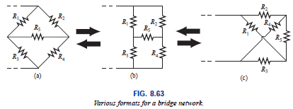
8.11 Bridge Networks
The bridge network may appear in one of the three forms as indicated in Fig. 8.63.
The network of Fig. 8.63(c) is also called a symmetrical lattice network if R2 = R3 and R1 = R4.
Figure 8.63(c) is an excellent example of how a planar network can be made to appear nonplanar.
Abu Ahmed Ferdaus, CSE, DU.

Slide 52
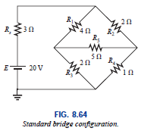
8.11 Bridge Networks
For the purposes of investigation, let us examine the network of Fig. 8.64 using mesh and nodal analysis.
Abu Ahmed Ferdaus, CSE, DU.

Slide 53
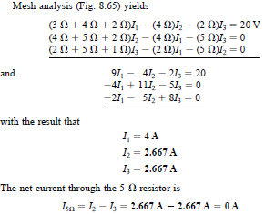
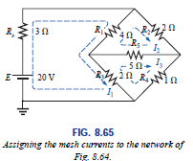
8.11 Bridge Networks
Abu Ahmed Ferdaus, CSE, DU.

Slide 54
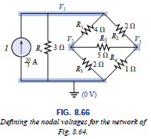
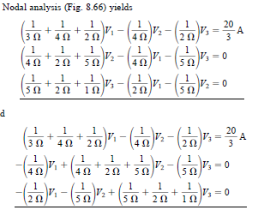

8.11 Bridge Networks
Abu Ahmed Ferdaus, CSE, DU.

Slide 55
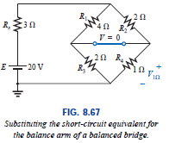
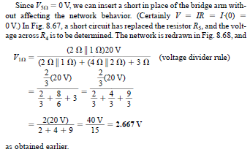
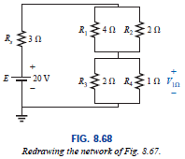
8.11 Bridge Networks
Abu Ahmed Ferdaus, CSE, DU.

Slide 56
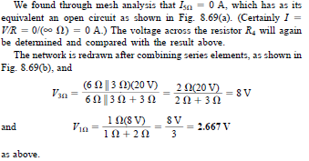
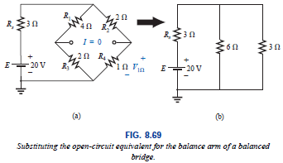
8.11 Bridge Networks
Abu Ahmed Ferdaus, CSE, DU.

Slide 57
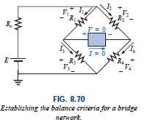
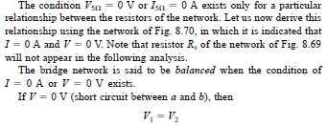
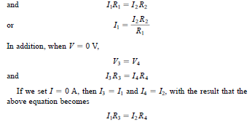
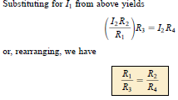
8.11 Bridge Networks
Abu Ahmed Ferdaus, CSE, DU.

Slide 58
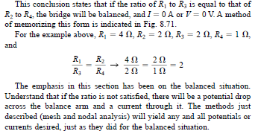
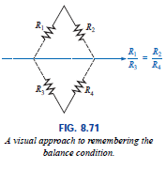
8.11 Bridge Networks
Abu Ahmed Ferdaus, CSE, DU.

Slide 59
8.12
Circuit configurations are often encountered in which the resistors do not appear to be in series or parallel.
Under these conditions, it may be necessary to convert the circuit from one form to another to solve for any unknown quantities if mesh or nodal analysis is not applied.
Two circuit configurations that often account for these difficulties are the wye (Y) and delta (Δ) configurations, depicted in Fig. 8.72(a). They are also referred to as the tee (T) and pi (Π), respectively, as indicated in Fig. 8.72(b).
Note that the pi is actually an inverted delta.
Abu Ahmed Ferdaus, CSE, DU.

Slide 60
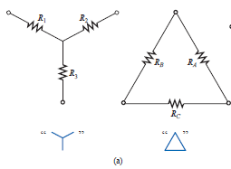
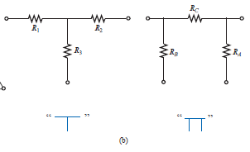
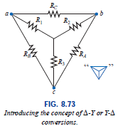

8.12
Abu Ahmed Ferdaus, CSE, DU.

Slide 61
8.12
The purpose of this section is to develop the equations for converting from D to Y, or vice versa. This type of conversion will normally lead to a network that can be solved using techniques such as those described in Chapter 7.
In other words, in Fig. 8.73, with terminals a, b, and c held fast, if the wye (Y) configuration were desired instead of the inverted delta (D) configuration, all that would be necessary is a direct application of the equations to be derived.
The phrase instead of is emphasized to ensure that it is understood that only one of these configurations is to appear at one time between the indicated terminals.
Abu Ahmed Ferdaus, CSE, DU.

Slide 62
8.12
It is our purpose (referring to Fig. 8.73) to find some expression for R1, R2, and R3 in terms of RA, RB, and RC, and vice versa, that will ensure that the resistance between any two terminals of the Y configuration will be the same with the D configuration inserted in place of the Y configuration (and vice versa).
If the two circuits are to be equivalent, the total resistance between any two terminals must be the same. Consider terminals a-c in the D-Y configurations of Fig. 8.74.
Abu Ahmed Ferdaus, CSE, DU.

Slide 63
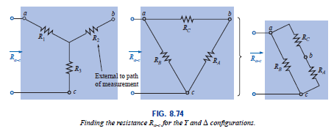
8.12
Abu Ahmed Ferdaus, CSE, DU.

Slide 64
For the time being
Thank You
Abu Ahmed Ferdaus, CSE, DU.

